Slide 1

ADD’s 2011
Self-Advocacy Summits
Presented by: Liz Weintraub, Hillary Spears, Mary Kay Rizzolo and Katie Arnold

Slide 2
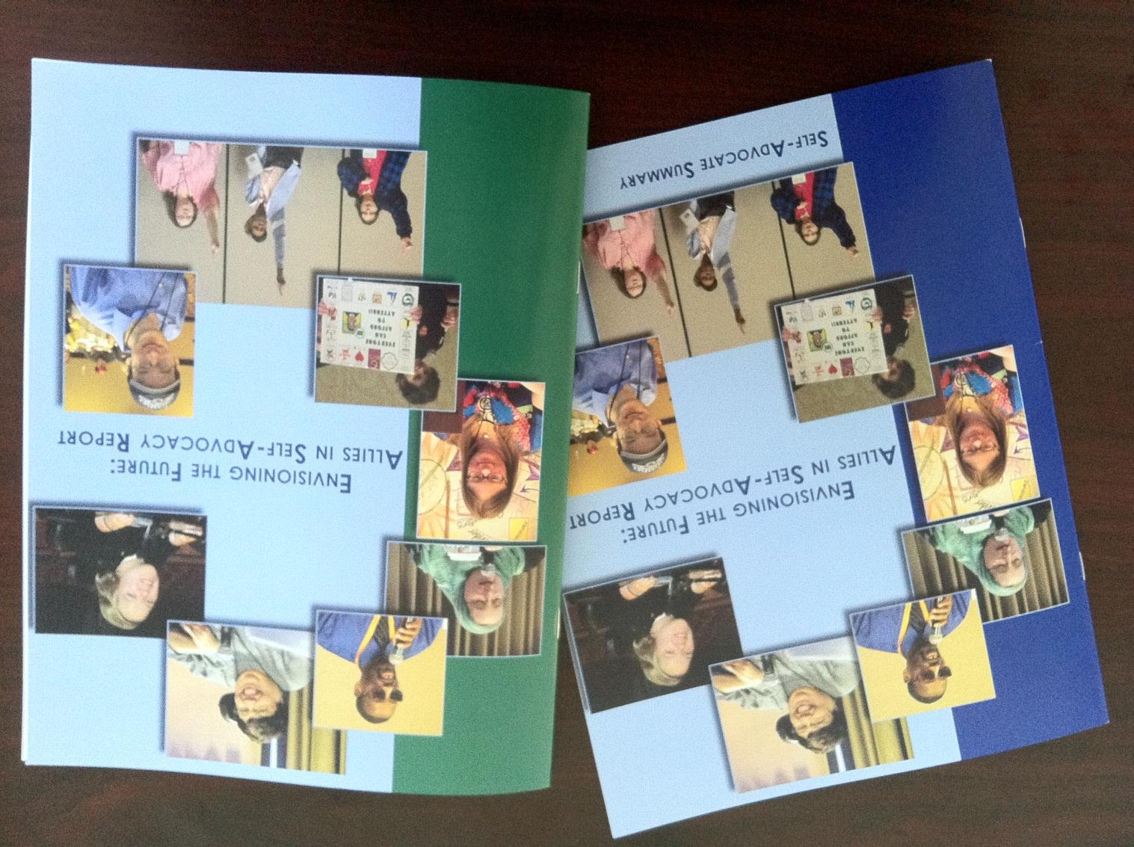
Reports are available here…
… and they will be available online soon!

Slide 3

The purpose of the summits:
#1
  to talk about what is happening in the states in self-advocacy – the support structures, activities, accomplishments and challenges;
Notes:
LW
ADD gave us four goals for the summits.
The first one is to talk about what is happening in the states in self advocacy – how it’s supported, what they are doing, what they’ve accomplished and what they are proud of. We will also talk about the challenges that you are facing in your state.

Slide 4

The purpose of the summits:
#2
  to plan steps we can take to strengthen and enhance current efforts at the state level;
Notes:
LW
The second goal is to talk about what are steps that you can take to strengthen your efforts within your state.

Slide 5

The purpose of the summits:
#3
  to develop recommendations for actions that we can take at the national level; and
Notes:
LW
The next goal is to develop recommendations in hopes that ADD will take it to Congress.

Slide 6

The purpose of the summits:
  to develop policy recommendations that can lead to a stronger, more effective, and long lasting self-advocacy movement across the country.
#4
Notes:
LW
The last goal is to develop policies that will make self advocacy stronger across the United States.

Slide 7

Members of the planning committee:
University Centers for Excellence in Developmental Disabilities (UCEDDs) – supported by the Association of University Centers on Disabilities (AUCD)
Notes:
ALN
Many people will be on your state team. They will be from different organizations. One organization is the UCEDD, or University Center for Excellence in Developmental Disabilities, in your state. The UCEDDs are supported by the Association of University Centers on Disabilities, or AUCD. AUCD is helping coordinate the summits.
– give example: National organization of UCEDDs.

Slide 8

Members of the planning committee:
Protection and Advocacy Organizations (P&As), supported by the National Disability Rights Network (NDRN)
Notes:
ALN
Another group is the Protection and Advocacy organization in your state. We call them P & A. The P & As are supported by the National Disability Rights Network.

Slide 9

Members of the planning committee:
Developmental Disabilities Councils (DD Councils), supported by the National Association of Councils on Developmental Disabilities (NACDD)
Notes:
ALN
Another organization is the Developmental Disabilities Council, in your state, sometimes called a DD Council. The DD Councils are supported by the National Association of Councils on Developmental Disabilities.

Slide 10


Members of the planning committee:
SABE (Self-Advocates Becoming Empowered)
NYLN (National Youth Leadership Network)
Notes:
ALN
SABE is the national organization for state self advocacy groups
NYLN is the national organization for youth self advocacy groups

Slide 11


Members of the planning committee:
National Association of State Directors of Developmental Disability Services (NASDDDS)
Human Services Research Institute (HSRI)
Notes:
ALN
NASDDDS is the national organization for State DD directors
HSRI – research & evaluation organization – you may have heard of them through “The Riot!”, a self-advocacy on-line newsletter.

Slide 12
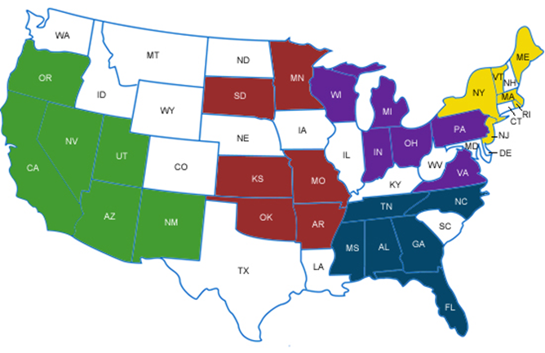
States involved in the 2011 summits
= Cities that hosted the summits
Notes:
ALN
There are a total of five regional summits, but these are not the same regions as SABE’s regions. Each summit will include six states. They are grouped by how close they are to one another. Your summit includes all of the states that are green on the left side of this map of the United States.

Slide 13


How State Teams Were Formed:
Required members:
1 adult self advocates (People First, SABE, etc.)
1 youth or young adult self advocate (NYLN, YLF, etc.)
1 Self-advocates representing autism self-advocacy
1 DD Council representative
1 P&A representative
1 UCEDD representative
1 DD services representative
Other optional members to include:
Other Youth self advocates (NCLD/Youth, etc.)
Other self advocates (local non-affiliated groups)
Other Self-advocates representing autism self-advocacy (ASAN, etc.)
Other leaders from ADD network organizations (DD Councils, P&As, and UCEDDs)
Other leaders from DD organizations (The Arc, UCP, Autism Society, etc.)
+
= Each team had 9-12 members

Slide 14
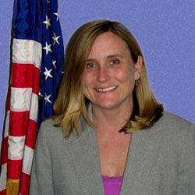
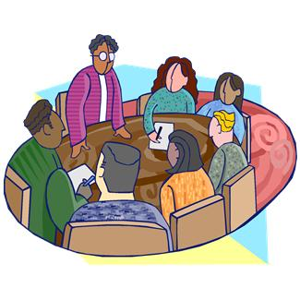
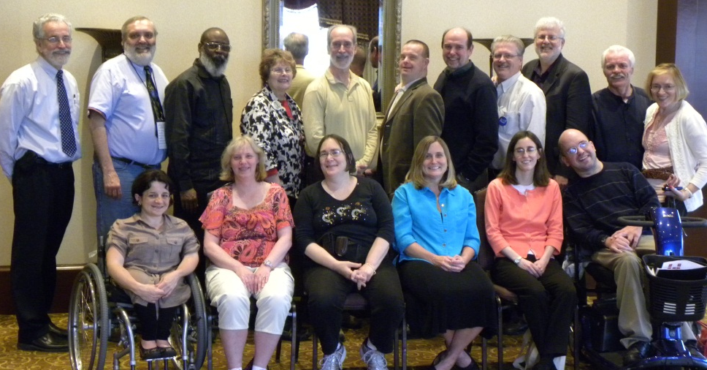
Overview of Process:
ADD’s commissioner
Planning committee
State teams

Slide 15
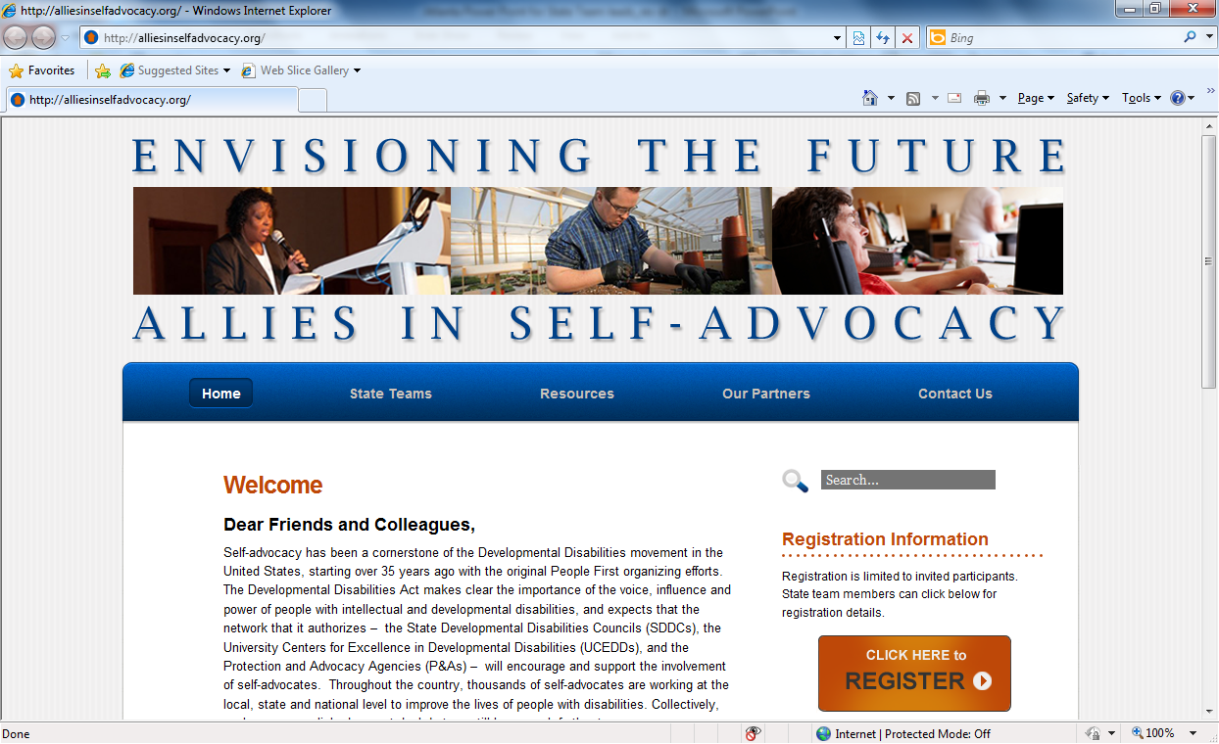
How will I find information about the summit ?
www.alliesinselfadvocacy.org
Notes:
LW
We hope that we have answered your questions and that you will feel comfortable coming to the Self Advocacy Summit. We look forward to meeting you. There is a lot of information available on the website as well. The address for the website is www.alliesinselfadvocacy.org and it is on the screen as well.
(TURN OVER TO DAWN FOR QUESTIONS)

Slide 16
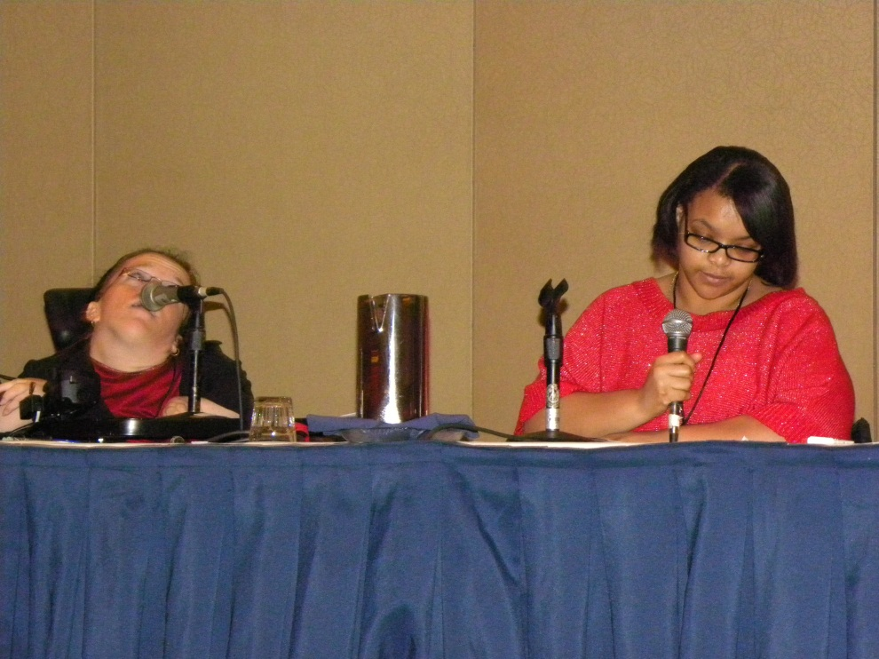
State teams answered these questions in their presentations :
What are the self advocacy organizations that currently exist in your state?
What are their major activities ?
What are the resources for the self advocacy organizations?
What has worked and not worked in your state for self advocacy organizations?
What are you most proud of in regards to self advocacy in your state?

Slide 17
www.alliesinselfadvocacy.org
Notes:
LW
We hope that we have answered your questions and that you will feel comfortable coming to the Self Advocacy Summit. We look forward to meeting you. There is a lot of information available on the website as well. The address for the website is www.alliesinselfadvocacy.org and it is on the screen as well.
(TURN OVER TO DAWN FOR QUESTIONS)

Slide 18
Agenda – Day One
Notes:
ALN
Like we already said, registration begins at 7:30. You should go to the registration desk, give them your name and get your name tag and folder. Next, look for the table with your state flag on it – if you don’t know your state flag, you just need to look at your name tag or folder and match it to the flag on the table. This is the table that you will sit at for breakfast so that you can meet & get to know your state team while you have breakfast.
The meeting officially begins at 9am. At 9:45, (just read the rest…)

Slide 19
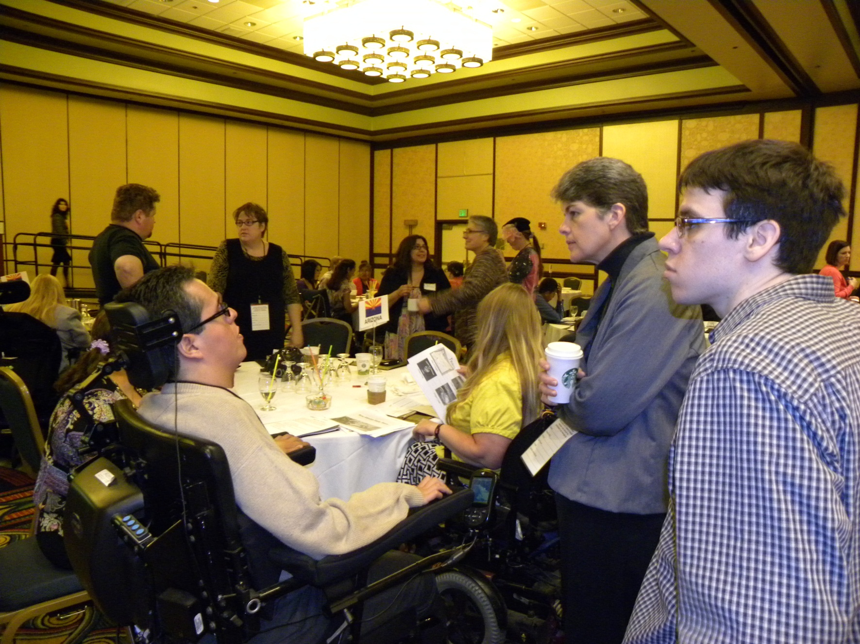
At the Summits…

Slide 20

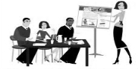


Agenda – Day One, continued
TIME | ACTIVITY
12:15-1:15 pm | Lunch
1:15-1:30 pm | Instructions for Organization/Peer Breakouts
1:30-2:30 pm | Breakout Session: Organization/Peer
2:30-3:00 pm | Break
3:00-3:30 pm | Instructions for State Team breakout: Developing Next Steps
3:30-5:00 pm | State Team Breakout Session: Developing Next Steps
5:00-5:30 pm | Open Mic
5:30-6:00 pm | Break
6:00-7:30 pm | Reception

Slide 21




Agenda – Day Two
TIME | ACTIVITY
7:30-8:30 am | Continental Breakfast with State Teams
8:30-8:45 am | Welcome
8:45-9:45 am | State Teams Report Back to group with next steps of state plans
9:45-10:00 am | Instructions for State Team Breakout Sessions: Recommendations
10:00-10:30 am | Break
10:30am-12:15 pm | State Team Breakout Session: National Recommendations
12:15-12:45 pm | State Sharing Tables
12:45-1:45 pm | Lunch
1:45 -2:30 pm | State Teams Report Back to Group with Recommendations
2:30-3:00 pm | Open Mic: Feedback for Summit
3:00- 3:15 pm | Leave for home

Slide 22
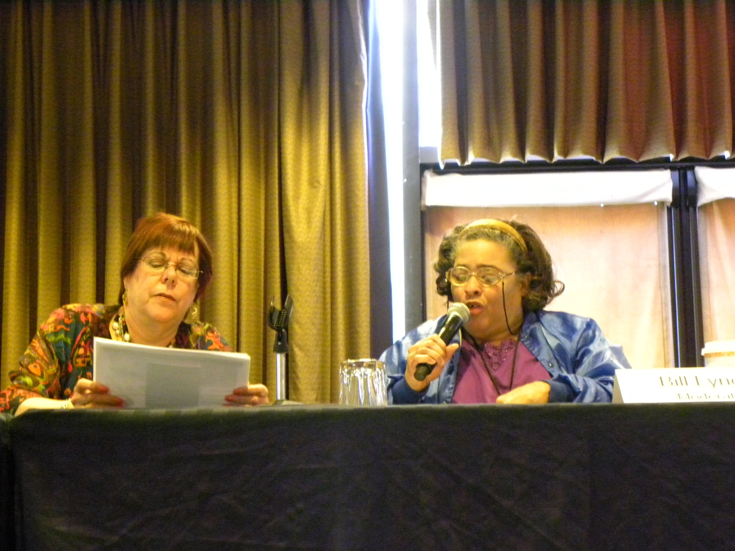

Slide 23
www.alliesinselfadvocacy.org
Notes:
LW
We hope that we have answered your questions and that you will feel comfortable coming to the Self Advocacy Summit. We look forward to meeting you. There is a lot of information available on the website as well. The address for the website is www.alliesinselfadvocacy.org and it is on the screen as well.
(TURN OVER TO DAWN FOR QUESTIONS)

Slide 24
What did we learn?
State teams did presentations on what their state was doing to promote self-advocacy.
  Some states are still trying to form statewide organizations.
  Some states knew each other well, while other teams were just starting to get to know each other
“Our state is maybe a little bit behind some of you all in getting organized as a statewide advocacy movement. But, I think this conference has allowed us to bring some heads together and make a start towards making up for that and moving forward into the future.”

Slide 25


Plans to Strengthen Self-Advocacy in States
1. Support peer training, mentoring, and leadership development (like serving on boards and committees)
2. Strengthen supports and funding for self-advocacy at the local, regional, and state level

Slide 26



3. Strengthen partnerships with other disability organizations and allies
4. Reach out and communicate with other self-advocates (like youth and other populations that are not part of the movement)

Slide 27

5. Educate the public about disability and self-advocacy (like getting rid of the “R” word)
6. Improve community services and supports (like education, transition, transportation, housing, and community living)

Slide 28

National Recommendations
State teams also came up with recommendations to support self-advocacy at the national level. Some recommendations were for actions that ADD could take in the short term. Other recommendations were for policy changes.

Slide 29




Things that ADD could consider doing in the short term:
Provide support to strengthen self-advocacy
  Support state self-advocacy information and training centers run by self-advocates
  Start a national resource center run by self-advocates to assist local and state self-advocacy organizations
  Provide support for self-advocacy through national DD Network associations (Association of University Centers on Disabilities, National Association of State Developmental Disabilities Councils, and National Disability Rights Network)

Slide 30


Things that ADD could consider doing in the short term (continued):
2. Promote inclusion and self-advocacy at the federal level:
  Hire and provide leadership opportunities for people with disabilities at the federal level
  Improve accessibility and use of respectful language
  Raise expectations for DD network and grantees about including self-advocates

Slide 31


Things that ADD could consider doing in the short term (continued):
3. Educate people about disability and self-advocacy
4. Work with other federal agencies on issues (like improving education, employment, transportation, and community services)

Slide 32
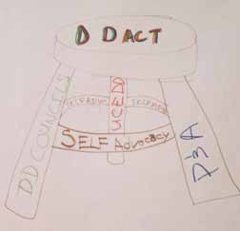
Bigger policy recommendations for the DD Act:
Make state self-advocacy information and training centers as an equal part of the DD Act. Some people call this adding the “fourth leg.” Another way to think about it is that it could support the UCEDDs, P&As, and DD Councils and make the DD Act stronger.

Slide 33

Bigger policy recommendations for the DD Act (continued):
Require the DD network to work together on a plan to strengthen self-advocacy
Require the UCEDDs and P&As to support self-advocacy
Require DD Councils to include a young self-advocate (under 28 years of age) on the Council
Promote inclusion of self-advocates with significant disabilities and SAs from underrepresented communities
Write rules (called regulations) in the DD Act to promote self-advocacy

Slide 34
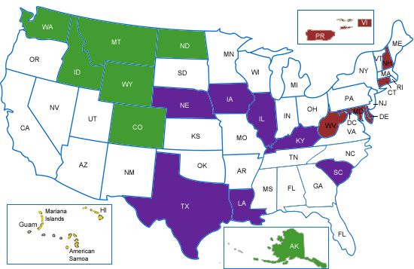
2012 and Beyond!

Slide 35


Questions
Notes:
Dawn

